Slide 1
Django Basic
Written by : Pooja Mishra

Slide 2
Contents..
What is web framework?
Python Web Frameworks?
Django VS Flask
What is Django ?
Why use Django ?
Who use Django ?
Based on MVT architecture
About DataBases
Django file structure
Demo project

Slide 3
What is web framework?
A web app framework or web framework is a software framework that is created to support the development of dynamic sites, web services, and web applications.
There are several web frameworks that have been designed to make coding and app development much easier for those in the industry.

Slide 4
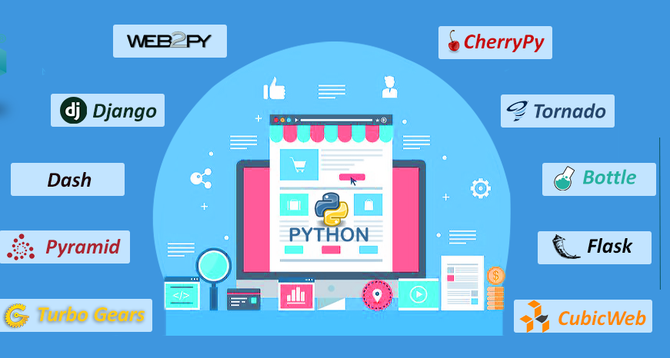
Python Web Frameworks?

Slide 5
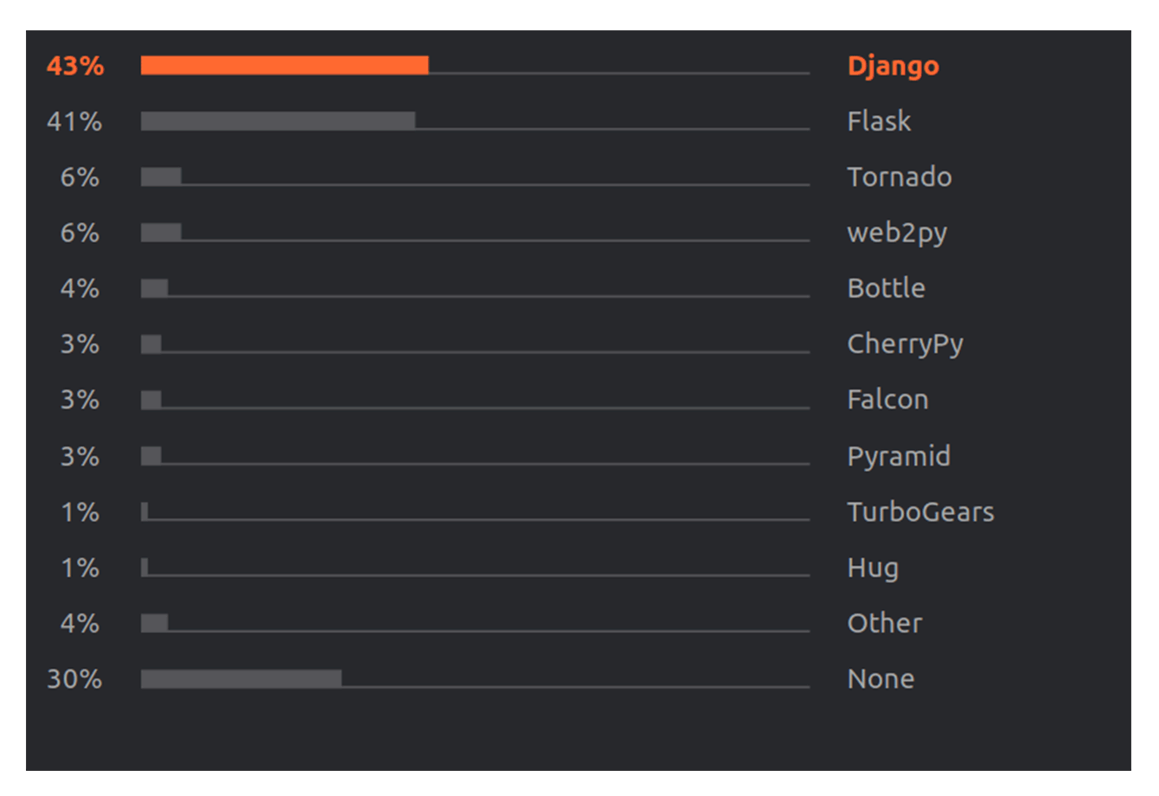
Mostly used ?

Slide 6
Django vs Flask
Django provides a full-featured Model–View–Controller framework. Its aim is to simplify the process of website development.
It relies on less code, reusable components, and rapid development
Flask, on the other hand, is a micro framework based on the concept of doing one thing well.
It doesn’t provide an ORM and comes with only a basic set of tools for web development.

Slide 7
What is Django ?
A high-level Python web framework.
Encourages rapid development and clean pragmetic design
“for perfectionists with deadlines”
Focus on automation and DRY.
Widely supported , many deployment options.

Slide 8
Who use?
Instagram
Mozilla
openStack
Disqus
Pinterest
Rdio
Etc….

Slide 9
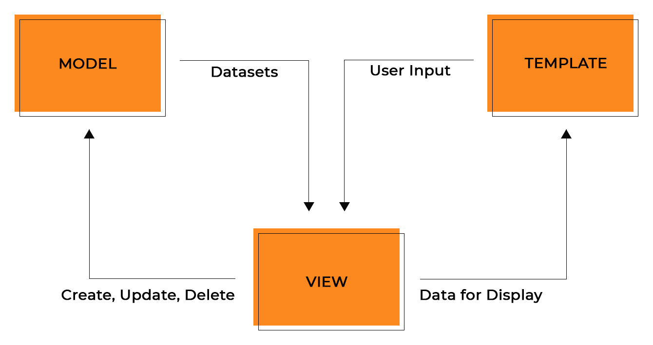
MVT architecture

Slide 10
Why use Django ?
it’s fast and simple
It’s secure
It suits any web application project
It’s well-established

Slide 11
Features of Django
ORM
Admin interface
Regex-based URL design
Templating System
Command- line job Framework
Versatile in Nature
High security

Slide 12
DataBases
So Django supports Various DataBases. you can set up any of them based on your comfort
MySql
Sqlite3
MangoDb
PostgreSQL
Oracle
Etc…

Slide 13
With Data Base
So I preferred MySql .
So I will show you in Demo that how to use data base.

Slide 14
[projectname]/
├── [projectname]/
├── __init__.py │
├── settings.py │
├── urls.py │
└── wsgi.py
└── manage.py

Slide 15
Demo
In demo we covering that,
How to create project?
What is view
What is URL
How to set up your project ?
Etc….

